Slide 1

TO SHOP OR NOT TO SHOP
Khushi Chaudhari, Adrian Franco,
Adelyn Lampley, Shreya Mohan, & Nick Wong

Slide 2
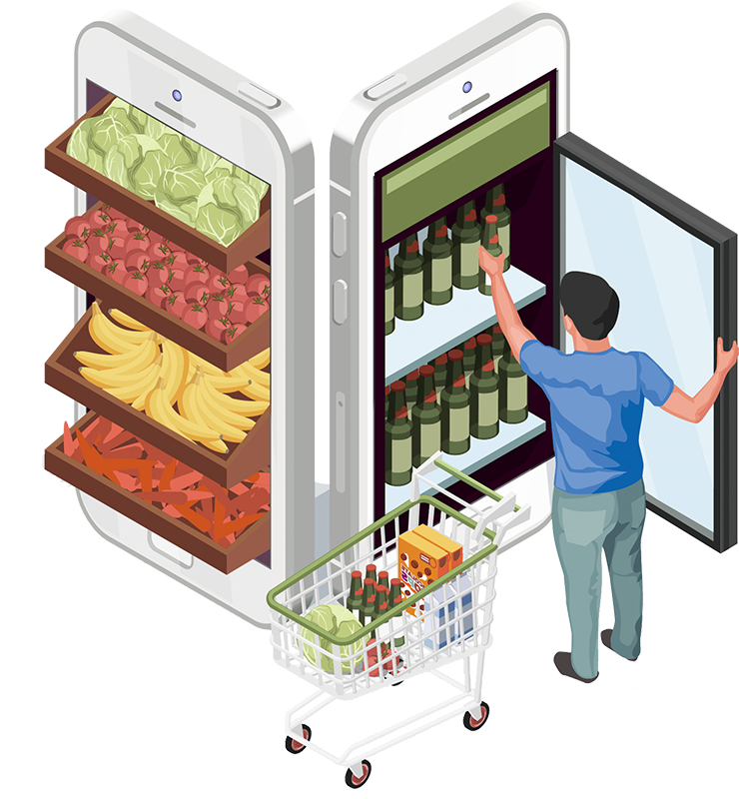
Project Proposal
Predicting whether an online shopper will purchase a product based on various features.

Slide 3

Goals
To see what aspects affect whether or not a user purchases something from an online store, and what their interactions with the website are like.

Slide 4
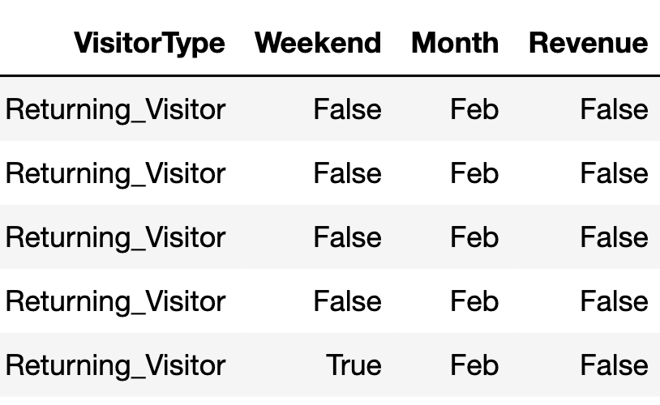
Data Cleaning: Before

Slide 5
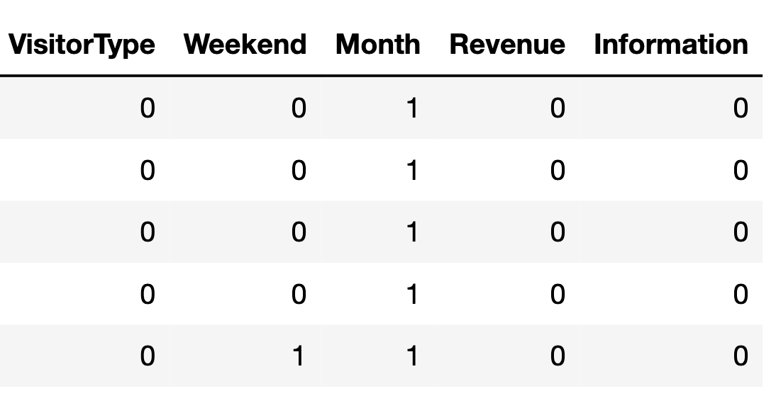
Data Cleaning: After

Slide 6
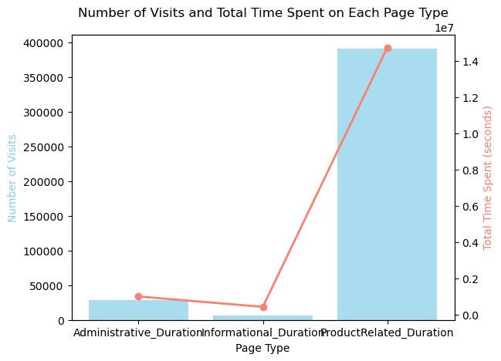
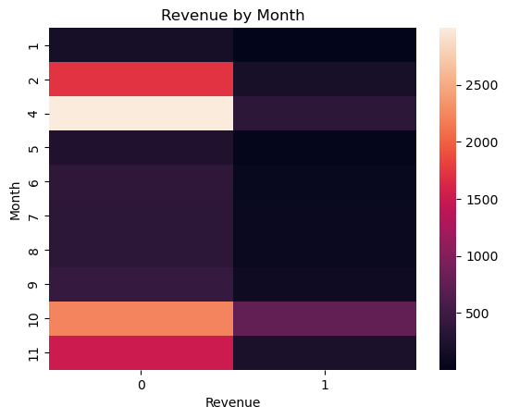
Graphs

Slide 7
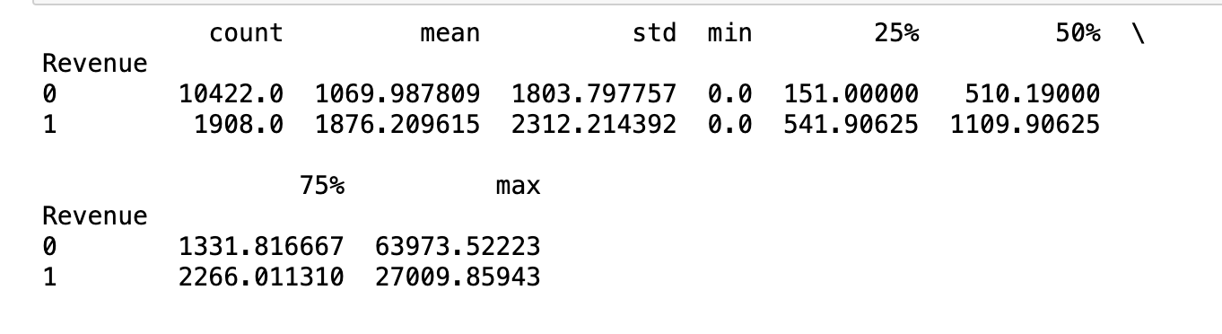
Descriptive Statistics
Descriptive Statistics: Time Spent on Product Related Page
Chi Square Test: Traffic Type and Revenue
Chi Square Test Statistic: 373.145
P-Value: 1.65

Slide 8

KNN Classifier: Greedy Selection
Used Greedy feature-selection algorithm to find the optimal combination of features to train our model on
Outputted the accuracy of all the combinations using up to 5 features
The model with the highest accuracy used 5 features and had a k value of 7

Slide 9
KNN Classifier: Comparing Models
Size of Tuple | K - Value | Accuracy
3 | 3 | 87.96%
3 | 5 | 88.44%
3 | 7 | 88.97%
5 | 3 | 87.96%
5 | 5 | 88.69%
5 | 7 | 89.05%

Slide 10
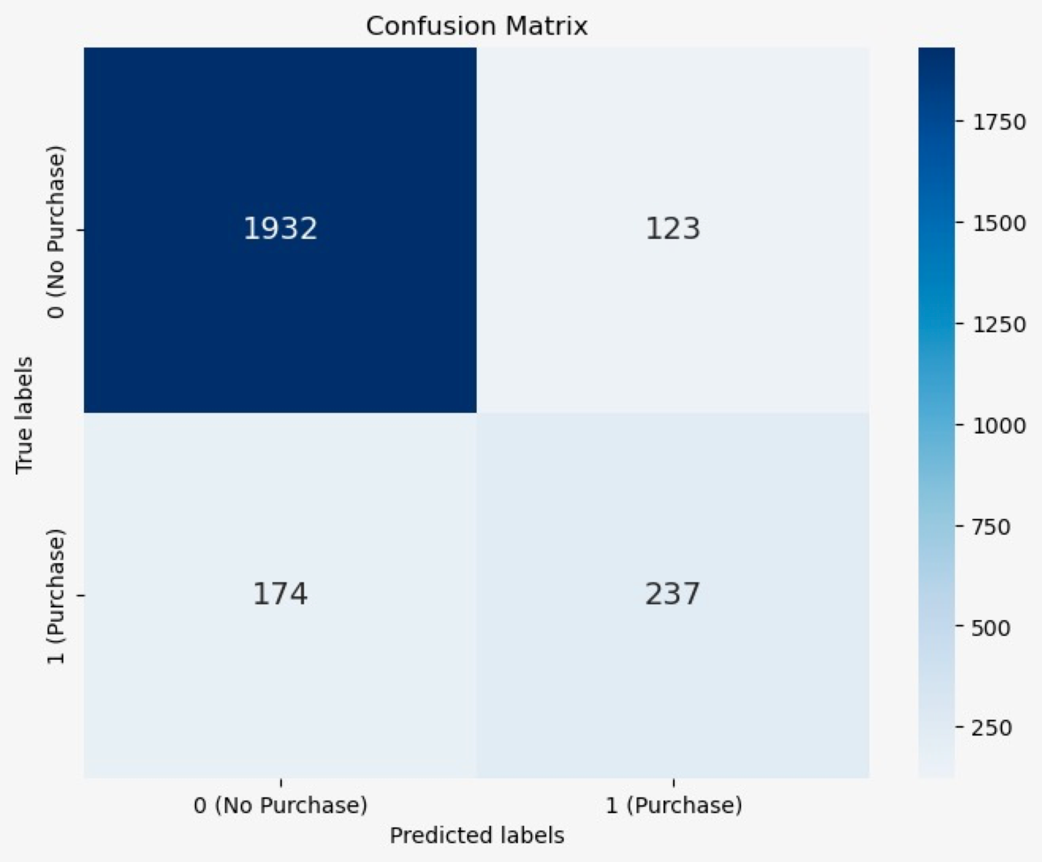
KNN Classifier: Best Model
Algorithm: KNN Classification
Selected features for training: Page Values, Month, Visitor Type, Region, Browser
Accuracy: 89.05%
Precision: 65.83%
Recall: 57.66%
F1 Score: 61.48%

Slide 11
Unsupervised Learning: Forward Selection
Selected Features: Administrative, Product Related, Page Value, Browser, Weekend
Accuracy: 86.9%

Slide 12
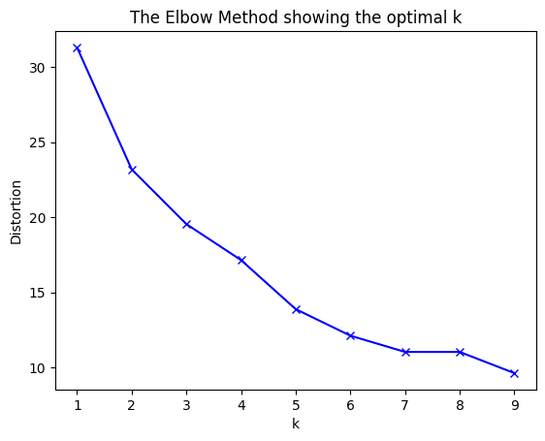
Unsupervised Learning: K Means Clustering

Slide 13
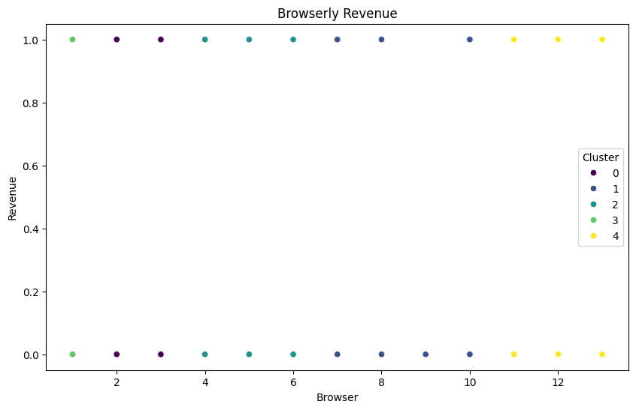
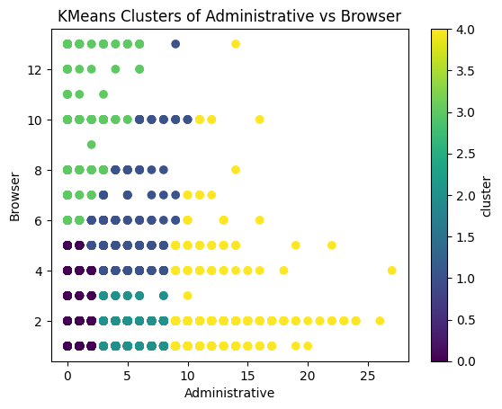
Clusters

Slide 14
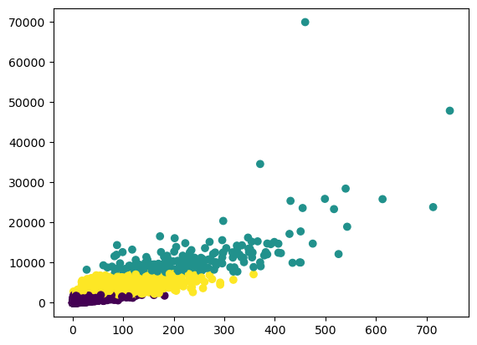
Cluster of Type of Page based on Number of Visits and Time Spent

Slide 15
Unsupervised Learning: Backward Selection
Selected Features: Administrative, Administrative Duration, Informational, Informational Duration, Product Related, Product Related Duration, Weekend, Month, Information
Accuracy: 86.82%

Slide 16
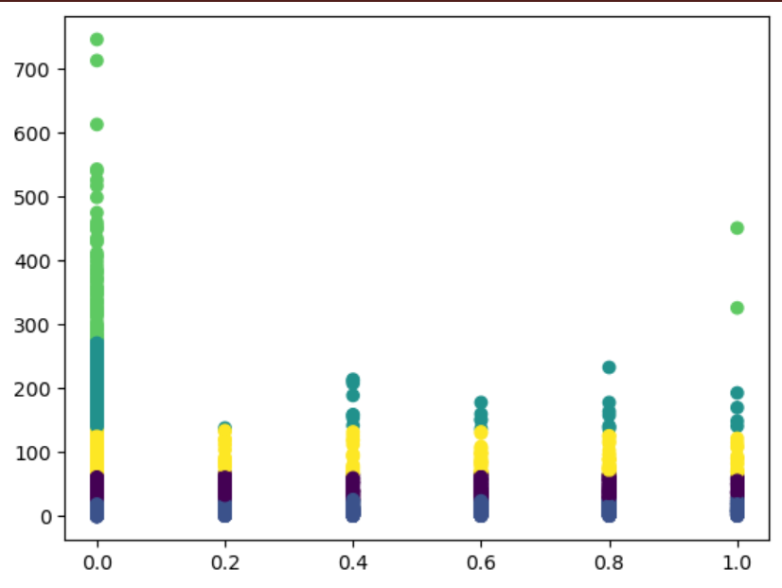
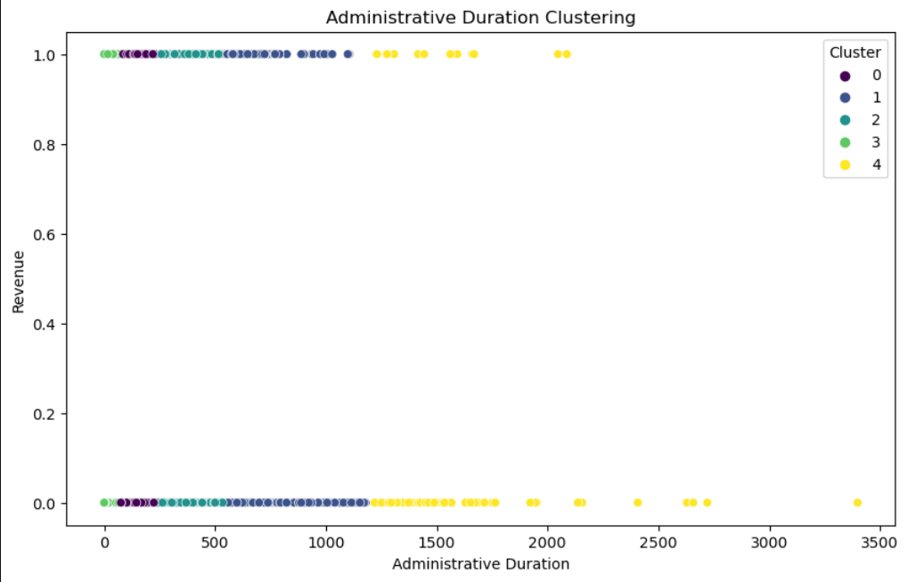
Unsupervised Learning: Backward Selection
Special Day and Page Visits

Slide 17
Conclusion
Features that affect an online shop receiving revenue we were able to see that the administrative, weekend, month, visitor type, page duration, and browser had the most influential effects.
One of the main things we had to consider when doing our analysis is that our data set had a large proportion of tuples where there was no revenue compared to making revenue.
Through both the exploratory data analysis and unsupervised learning we were able to notice the large impact that the browser type had on revenue as some browsers resulted in a larger proportion of revenue than others.

Slide 18
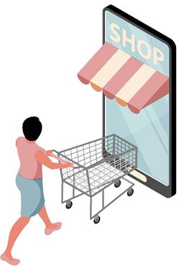
Questions
What variable was correlated with revenue that was found through the chi square test?
Name one variable that was selected for the KNN classifier using the greedy selection algorithm.
What was one of the clusters that was an outcome of the unsupervised learning algorithm?

Slide 19
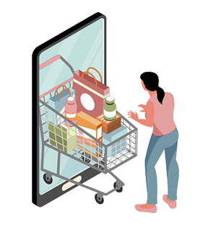
THANKS

